Slide 1
The implications of
Open Notebook Science
and other new forms of scientific communication for Nanoinformatics
Nanoinformatics 2010
Jean-Claude Bradley
Associate Professor of Chemistry
Drexel University
November 3, 2010

Slide 2

The Evolution of Automation in Scientific Research
TODAY
SMIRP bridge
Laboratory Information Management Systems
Collaborative Electronic Notebook Systems
Human Managed
Fully Autonomous
Scientific Research Systems
Single Instrument Automation
Human /Autonomous Agent Hybrid Systems
LIMS
CENS

Slide 3
Capturing semantic structure in research
at the point of data entry
Standard
Modular
Integrated
Research
Protocols

Slide 4
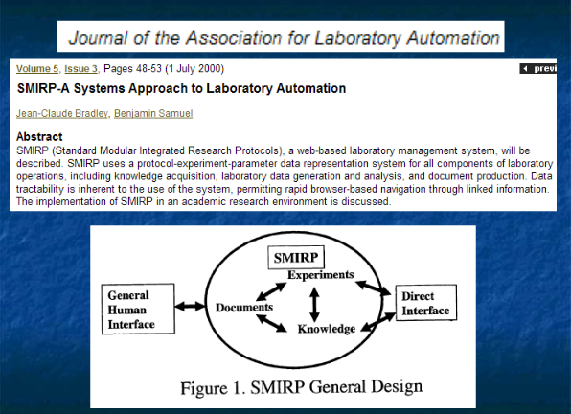

Slide 5
The SMIRP model for a hybrid Human/Autonomous Agent System
Browser
SMIRP
Human
Agent
Autonomous
Agent
(Bot)
Anthropomimetic
Design
Excel

Slide 6
Approaches to Collaborative Electronic Notebooks
rigid
flexible
Structured
Generally
domain
specific
Adaptable
Unstructured
SMIRP
compromise:
Rigid information representation
Flexible linking of modules
http://smirp.drexel.edu

Slide 7
Fundamental Information Representation in SMIRP
(People)
Module 1
Module 2
(Company)
(Name)
Parameter 1
Parameter 4
(Name)
(Employee of)
Parameter 2
Parameter 5
(Address)
(email)
Parameter 3
instance
instance
Bill Gates
Record 1
Record 2
Microsoft

Slide 8

Two approaches to the development of databases
Communicate
anticipated
need
Design
database
structure
Let database structure
evolve
through use
SMIRP

Slide 9
Case-study:
Evolution of SMIRP structure in a nanoscience laboratory
Location | Drexel University Department of Chemistry
Users | faculty, undergraduate students, graduate students, librarians and other university personnel
Period | Feb 1999 – April 2001, with a detailed focus on last 7 months (Sept 2000-April 2001)
Total accounts (last 7 months) | 78
Active Accounts (added records) | 50
Administrators (changed database structure) | 9

Slide 10
Most Active Module Categories (9/00 – 4/01)
118 modules
1/3 account for
98% of activity
Maintenance
1%
Human
Resource
Management
13%
Labwork
14%
Knowledge
Processing
72%

Slide 11
Activity Analysis by Category over Time
8000
7000
6000
5000
4000
3000
2000
1000
0
Knowledge Processing
2000-10-3
Laboratory Work
2000-10-17
Human Resource Management
2000-10-30
2000-11-12
2000-11-25
2000-12-8
2001-1-3
Maintenance
2000-12-21
2001-1-16
2001-1-30
2001-2-12
2001-2-25
2001-3-10
2001-3-23
2001-4-5
2001-4-18

Slide 12
Most Active Human Resource Management Modules
Project
Manager
5%
Recruitment
events 2%
Errors
5%
Productivity
Tracking
14%
Workstudy
hours reporting
46%
People 28%

Slide 13
Most Active Maintenance Modules
Order
forms
9%
SMIRP
Problems
22%
Vendor
15%
Orders
19%
Laboratory
materials
16%
Invoice (TEM/SEM and
other instrument charges)
19%

Slide 14
Most Active Knowledge Processing Modules
Reformat
Reference
requests
20%
Find
Reference
66%
Journal 9%
Knowledge
Filter 3%
Publisher
Document Production
Reference Processing
Parameter Correlation
Data source files
Experimental Conclusion Generation
Knowledge consolidation

Slide 15
Real-Time Workflow Designs
Seamless Integration of Human and Autonomous Agents in Workflows
State A
Human
(default)
State B
Automated

Slide 16
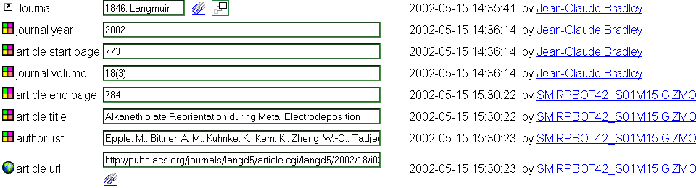
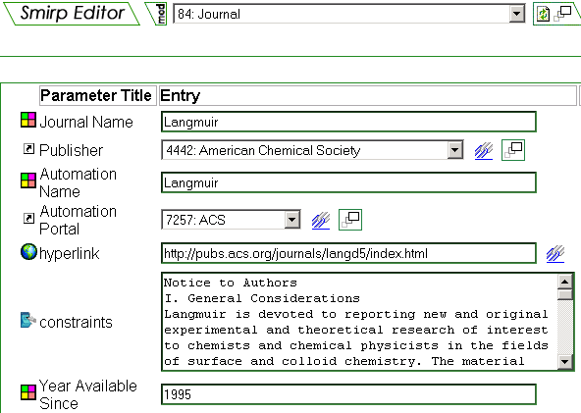
Workflow for Extraction of Article information and URL
Queries Web and extracts information

Slide 17
Most Active Laboratory Modules
Protocol Prototyping
25%
Pd onto Carbon
Nanofibers
17%
Electroless plating
on Membranes
9%
Electrodeposition of
Pd on Graphite
29%
Synthesis of Pd catalysts
by Bipolar electrochemistry
5%
TEM Micrographs
Of Pd on C
3%
Preparation of Silver rods for SCBE
TEM Micrographs Of Pd on C
SCBE on membranes
Hydrogenation of Crotonaldehyde using Pd Catalysts
Reduction of Methylene blue by Pd
Metal Particles in a Field
Pd particle size
analysis using TEM
3%

Slide 18
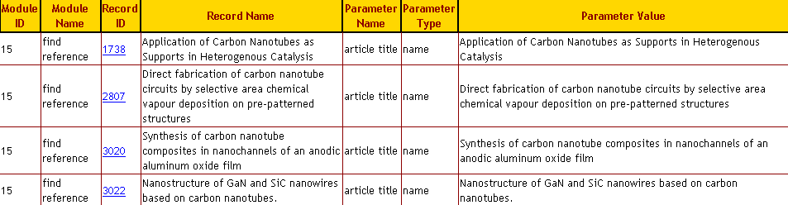
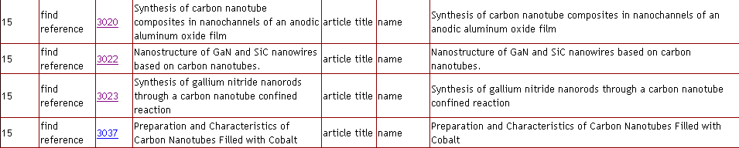
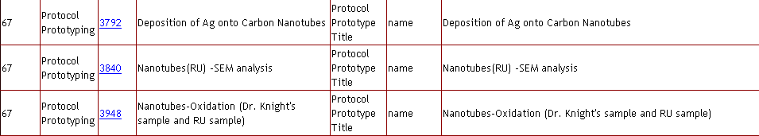
Keyword Search Results: example “nanotube”

Slide 19
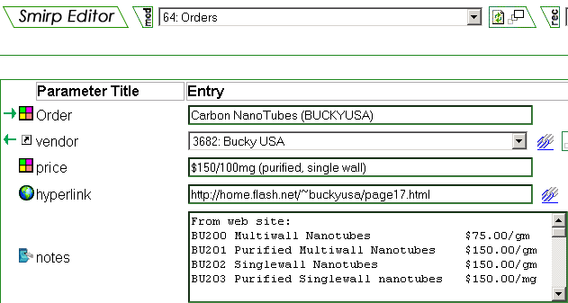
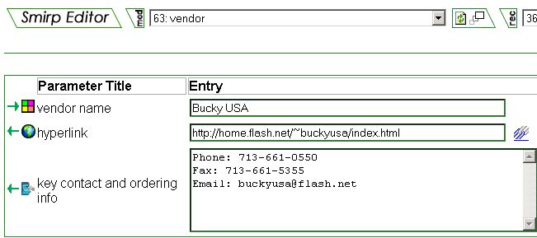
From Keyword to Orders

Slide 20
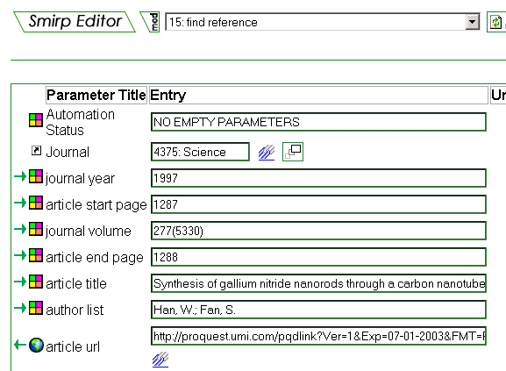
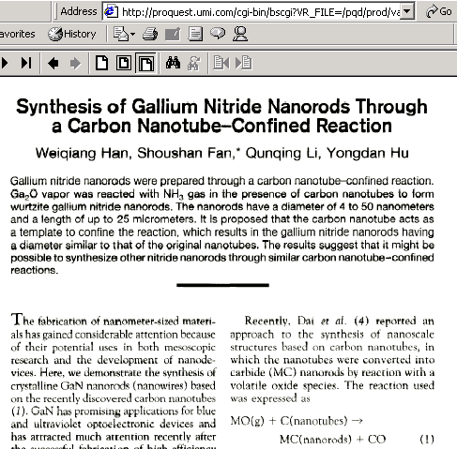
From Keyword to Article

Slide 21
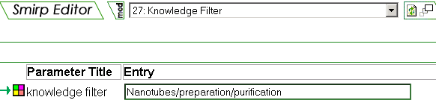

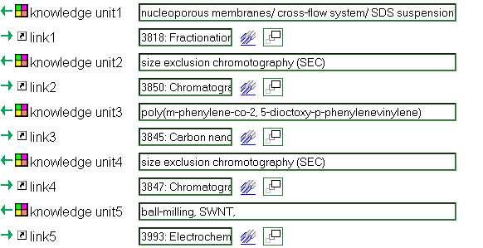
From Keyword to Knowledge Filter

Slide 22
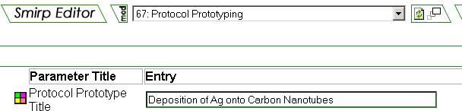
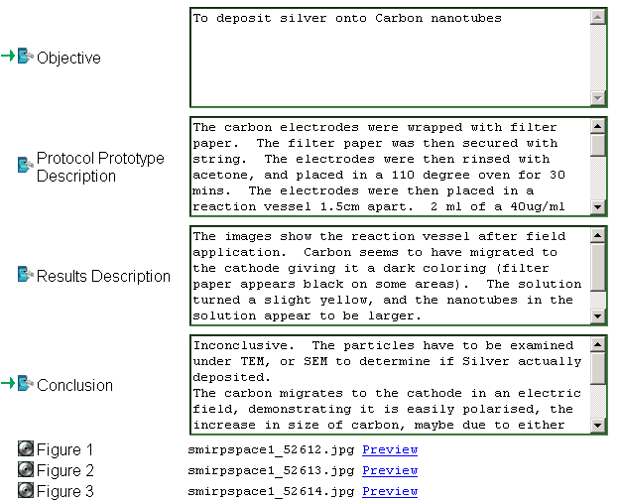
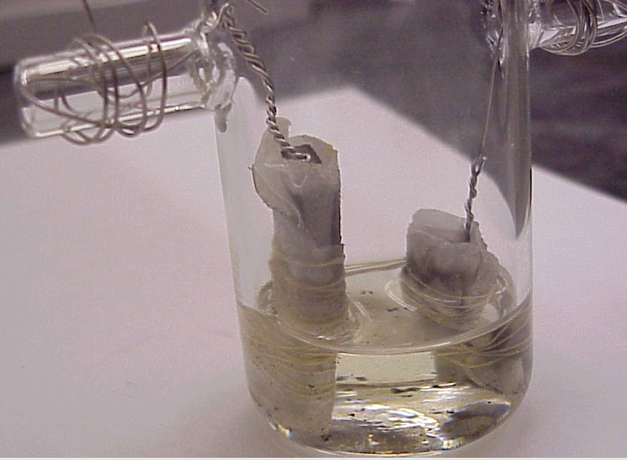
From Keyword to Protocol Prototyping

Slide 23
Sharing results semi-automatically:
SMIRP Knowledge Product
Single Experiment
Full Context
Supporting Data
Not suitable for traditional peer-reviewed publications

Slide 24


Non-traditional publication options in 2003
(Elsevier)

Slide 25
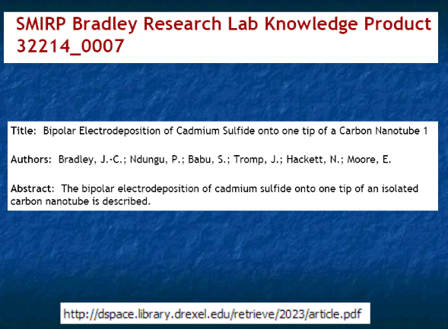

Slide 26
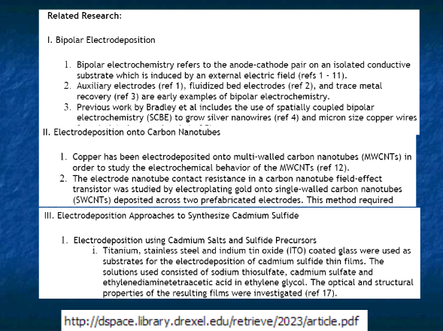

Slide 27
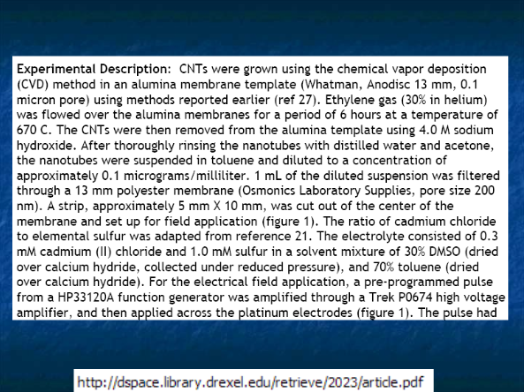

Slide 28
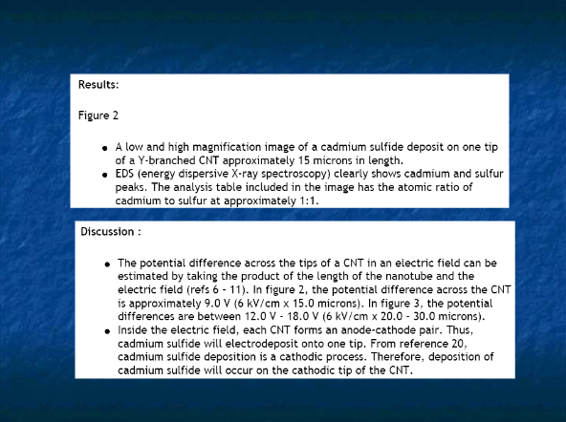

Slide 29
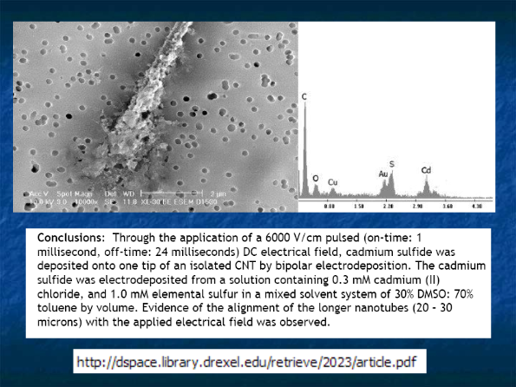

Slide 30
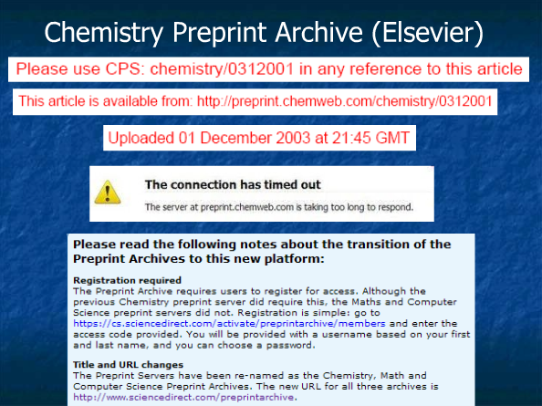

Slide 31
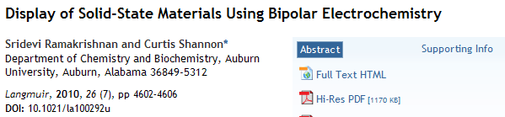
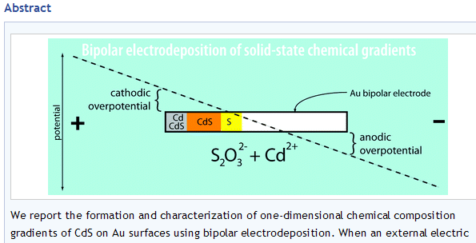
To Cite or Not to Cite?

Slide 32



Slide 33
What is a Scientific Precedent in Academia?
What is a Scientific Precedent in Patent Law?
“I would never consider a claim made in a patent as blocking an author's claim of novelty.” Langmuir Editor

Slide 34
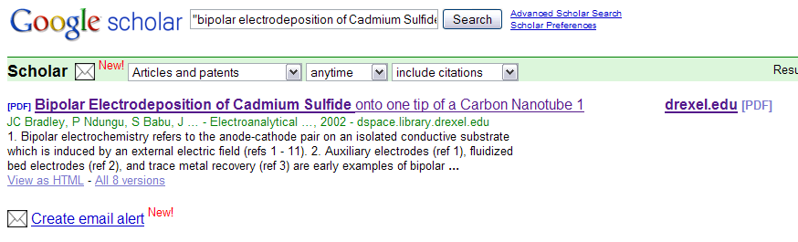
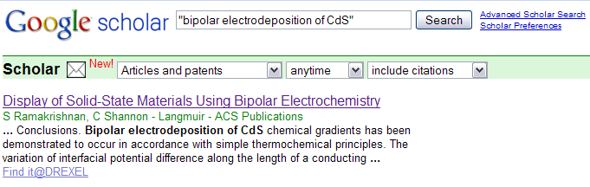
What is Scholarship?
*also indexed in Chemical Abstracts!

Slide 35
The UsefulChem Project (2005)
What would happen if a chemistry project was completely transparent in real time?

Slide 36
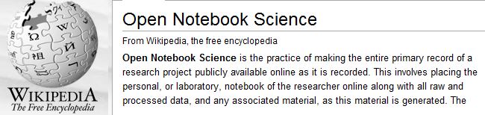
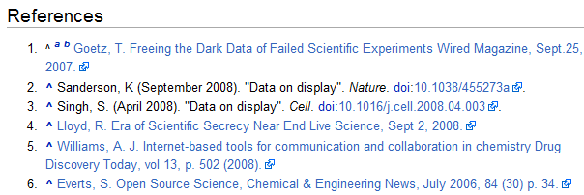
Motivation: Faster Science, Better Science

Slide 37
TRUST
PROOF

Slide 38
Strategy for an Open Notebook:
First record then abstract structure
In order to be discoverable use Google friendly formats (simple HTML, no login)
In order to be replicable use free hosted tools (Wikispaces, Google Spreadsheets)

Slide 39
UsefulChem Project: Open Primary Research in Drug Design using Web2.0 tools
Rajarshi Guha
Indiana U
Tsu-Soo Tan
Nanyang Inst.
Docking
JC Bradley
Drexel U
Synthesis
Phil Rosenthal
UCSF
(malaria)
Dan Zaharevitz
NCI
(tumors)
Testing
Notes:
39

Slide 40

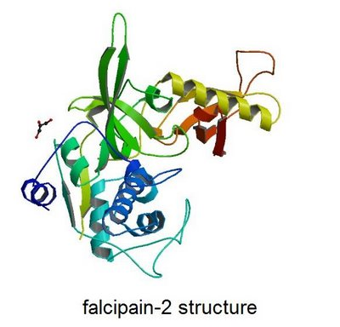
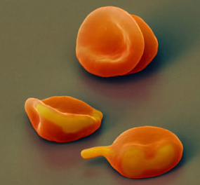
Malaria Target: falcipain-2
involved in hemoglobin metabolism
Dana.org
Notes:
40

Slide 41
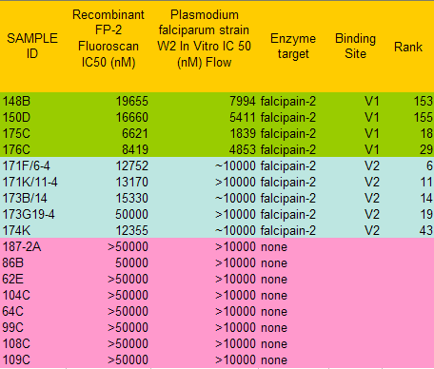
Outcome of Guha-Bradley-Rosenthal collaboration
Notes:
41

Slide 42
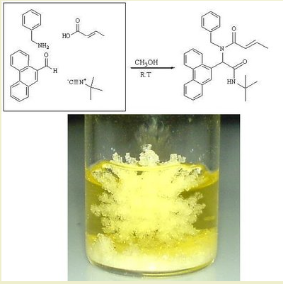
The Ugi reaction: can we predict precipitation?
Can we predict solubility in organic solvents?

Slide 43


Crowdsourcing Solubility Data

Slide 44
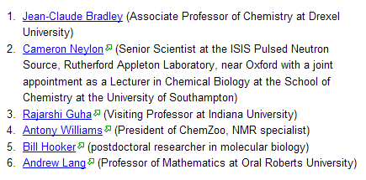
ONS Challenge Judges

Slide 45
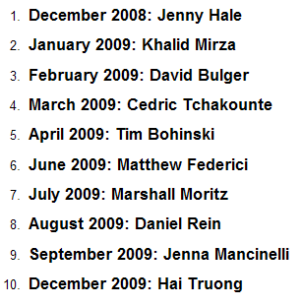

ONS Submeta Award Winners

Slide 46
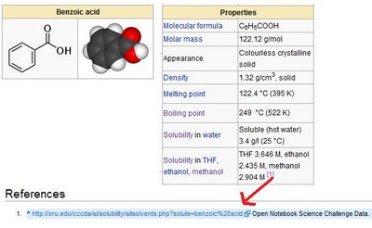
Data provenance:
From Wikipedia to…

Slide 47
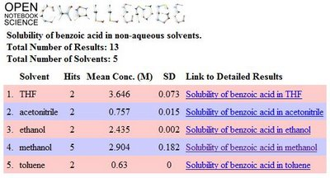
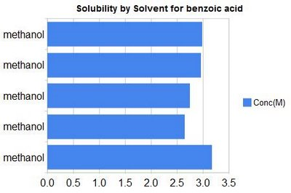
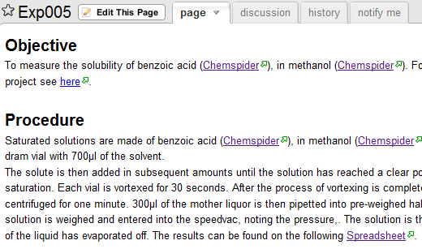
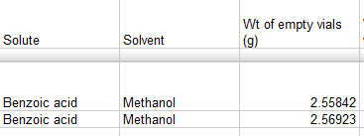
…the lab notebook and raw data

Slide 48
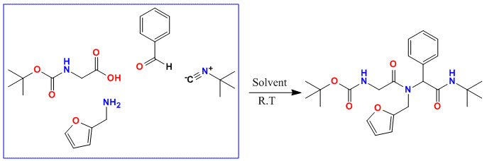
How does Open Notebook Science fit with traditional publication?
Concentration (0.4, 0.2, 0.07 M)
Solvent (methanol, ethanol, acetonitrile, THF)
Excess of some reagents (1.2 eq.)

Slide 49
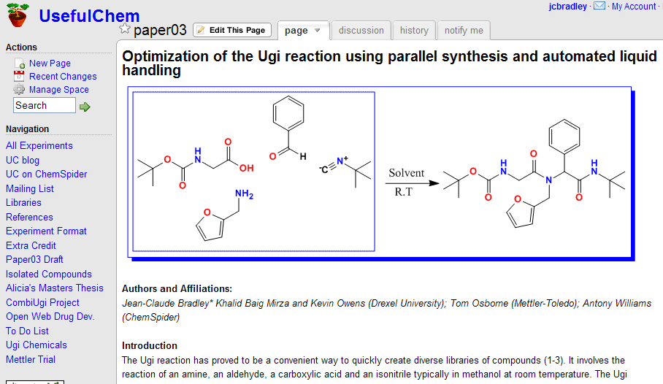
Paper written on Wiki

Slide 50
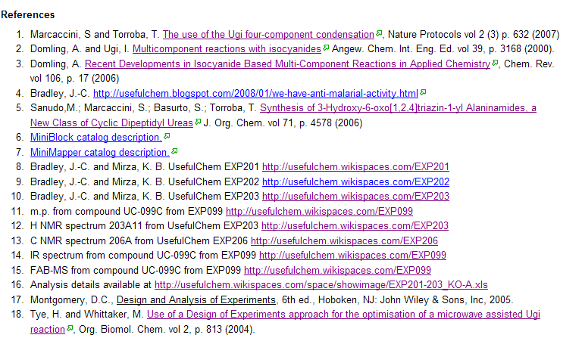
References to papers, blog posts, lab notebook pages, raw data

Slide 51
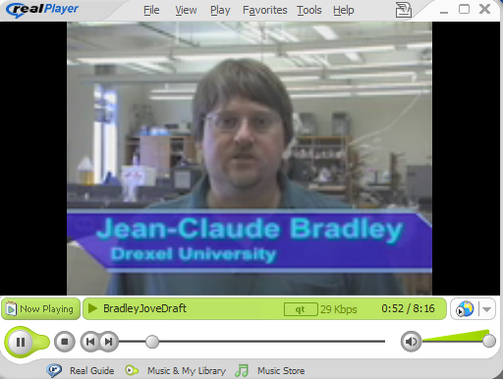
Paper on Journal of Visualized Experiments (JoVE)

Slide 52
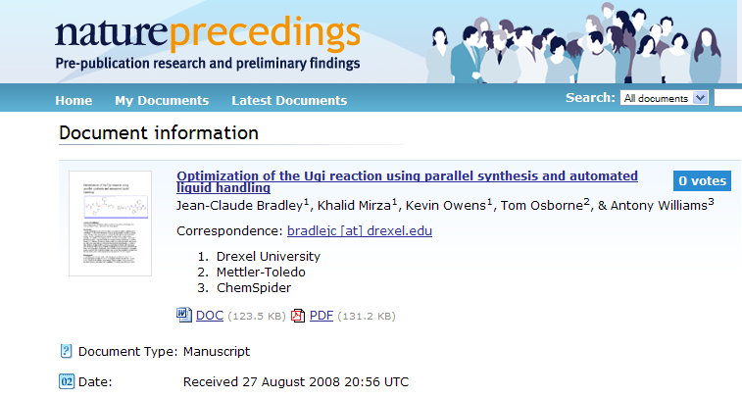
Pre-print on Nature Precedings

Slide 53
ONSArchive: Semi-Automated Snapshot of the Entire Scientific Record
Automated Download of Spreadsheets and Parsing of Web Pages
Manual Backup of Spectral Data Files
Manual Export of Wikispaces
Notes:
53

Slide 54
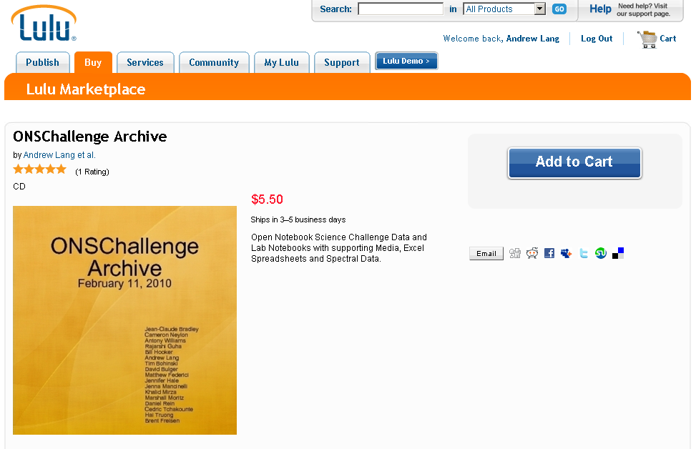
Lulu.com Data Disks
Notes:
54

Slide 55
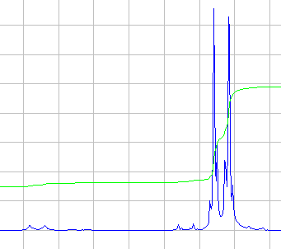
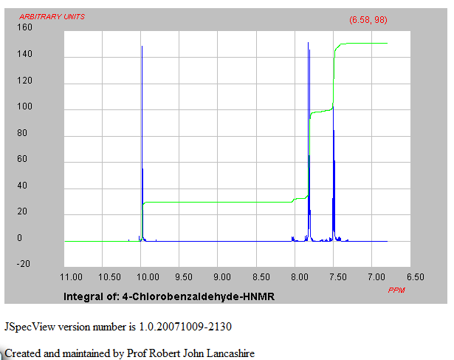

Interactive NMR spectra using JSpecView and JCAMP-DX
Notes:
55

Slide 56
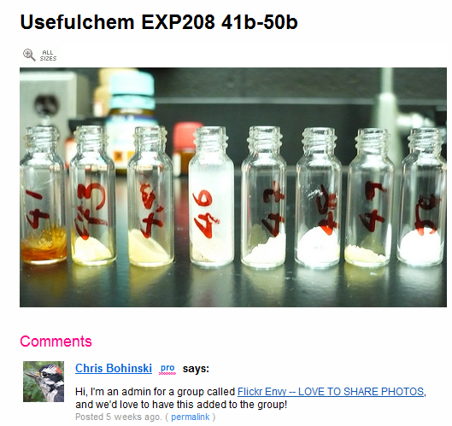

Raw Data As Images
Splatter?
Some liquid
Notes:
56

Slide 57
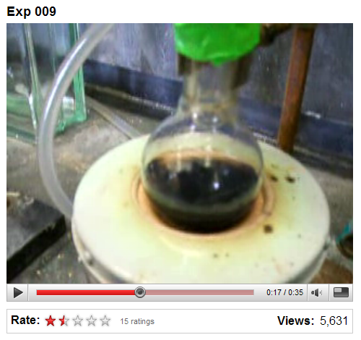
YouTube for demonstrating experimental set-up
Notes:
57

Slide 58
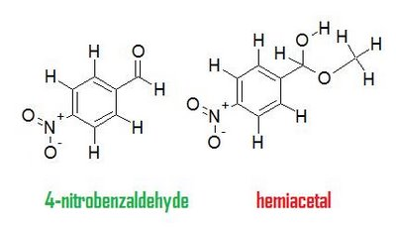
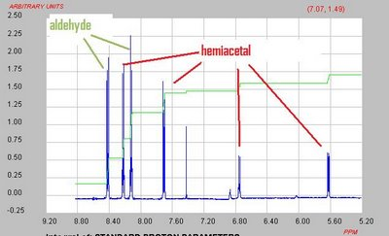

The importance of raw data availability
Missed in a prior publication on solubility for this compound
Notes:
58

Slide 59


The Intersection of Open Notebooks (Bradley/Todd) and IP implications
Open Notebook could have blocked patent if done earlier

Slide 60

Convenient web services for solubility measurement and prediction
(Andrew Lang)

Slide 61

Other Web Services…
General Transparent Solubility Prediction
(Andrew Lang)

Slide 62

Semi-Automated Measurement of solubility via web service analysis of JCAMP-DX files
(Andy Lang)
Notes:
62

Slide 63

Integration of Multiple Web Services to Recommend Solvents for Reactions
(Andrew Lang)

Slide 64

Notes:
64

Slide 65

Notes:
65

Slide 66

Reaction Attempts Book

Slide 67

Reaction Attempts Book: Reactants listed Alphabetically

Slide 68


For all Formats of ONS Projects
Notes:
68

Slide 69


Dynamic links to private tagged
Mendeley collections
(Andrew Lang)

Slide 70
Conclusions
Open Notebook Science can provide an additional channel to communicate useful scientific information
Recording first for human consumption followed by abstracting the semantics later works but the format will be field specific
As long as proof is valued over trust there is no limit to what useful forms of scientific communication will emerge.

